Slide 1
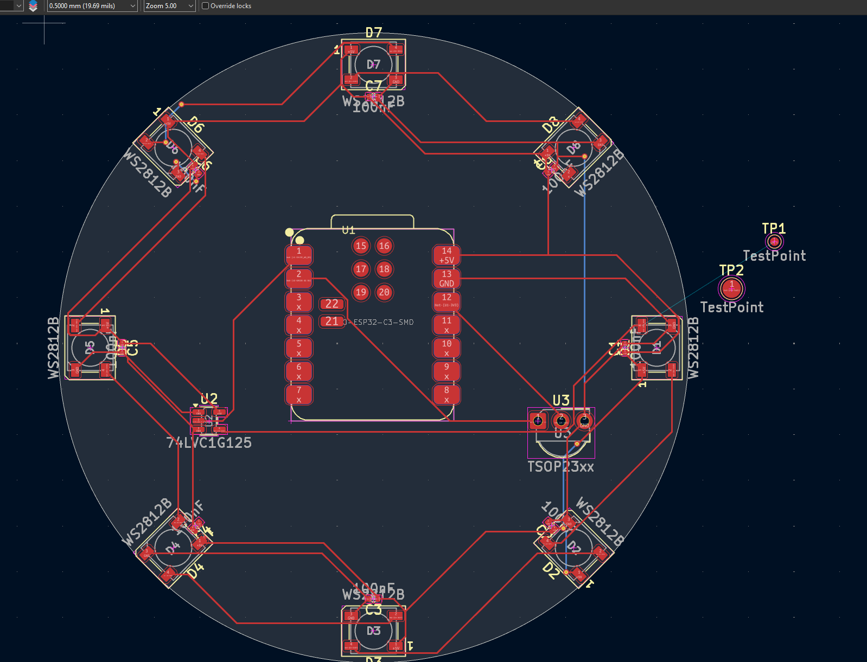
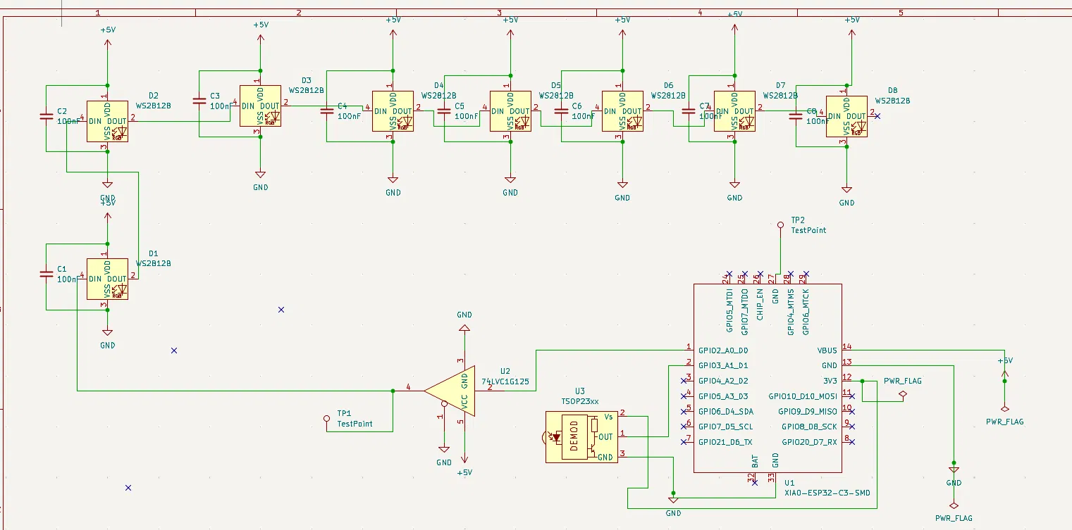
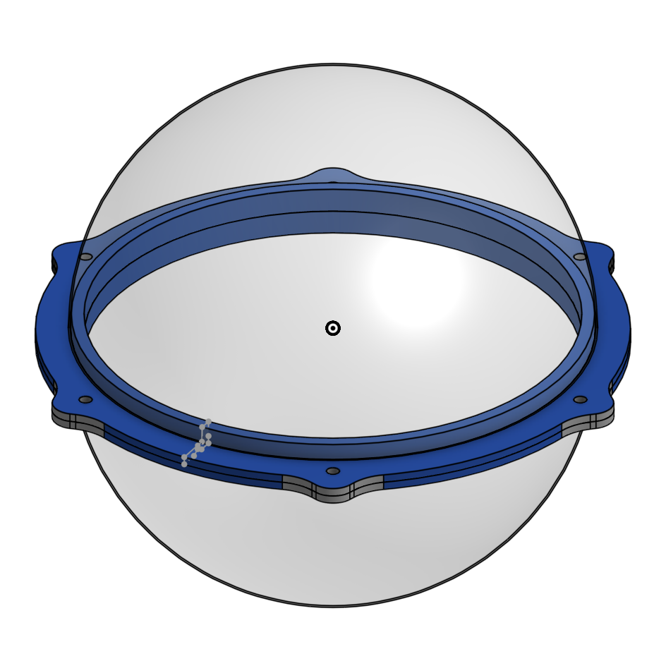
Wireless System Design
Gus Geremia, Vikram Jangid, Danish Saini, Manya Goutam
Catholic Charities: CORAL
Professor Zand | TA Nicolas
Problem
Traditional holiday lighting lacks wireless individual control, making dynamic large-scale displays impractical
Weather made it difficult to keep the ornaments from functioning
Solution
Custom SnoPixel v4 PCB: XIAO ESP32-C3 + 13× WS2812B NeoPixels on a compact circular board
74LVC1G125 level shifter for reliable 3.3V→5V signal drive; TSOP23xx IR receiver for local control
Creating a weatherproof that is is a threaded hemispheres
Confidential

